Slide 1
User Interaction and Intuitive Navigation
Android Developer Fundamentals
Lesson 4

Slide 2

4.2 Menus
This work is licensed under a Creative Commons Attribution-NonCommercial 4.0 International License
This work is licensed under a Creative Commons Attribution-NonCommercial 4.0 International License
Android Developer Fundamentals
Menus

Slide 3
Contents
App Bar with Options Menu
Contextual menus
Popup menus

Slide 4
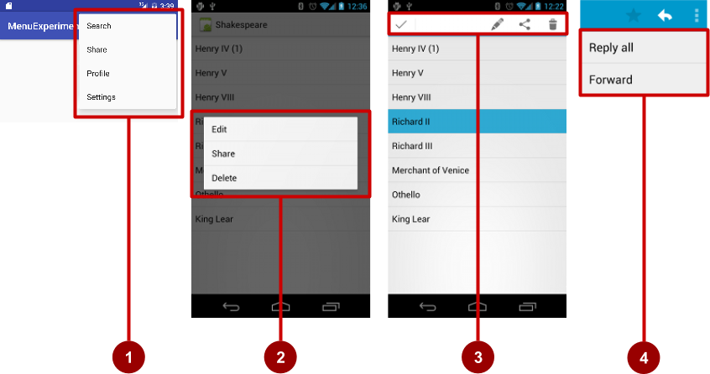
Types of Menus
App bar with options menu
Contextual menu
Contextual action bar
Popup menu

Slide 5
App Bar with Options Menu

Slide 6
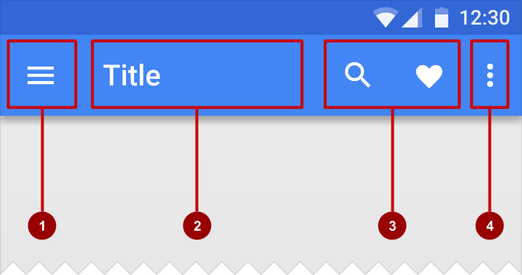
What is the App Bar?
Bar at top of each screen—(usually) the same for all screens
Nav icon to open navigation drawer
Title of current activity
Icons for options menu items
Action overflow button for the rest of the options menu

Slide 7
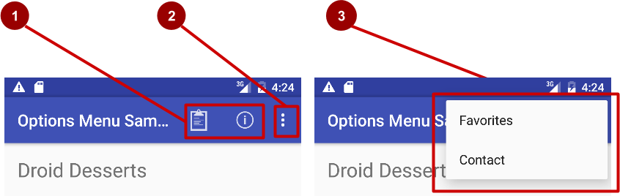

What is the options menu?
Action icons in the app bar for important items (1)
Tap the three dots, the "action overflow button" to see the options menu (2)
Appears in the right corner of the app bar (3)
For navigating to other activities and editing app settings

Slide 8
Adding Options Menu

Slide 9
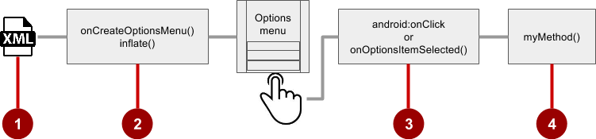
Steps to implement options menu
XML menu resource (menu_main.xml)
onCreateOptionsMenu() to inflate the menu
onClick attribute or onOptionsItemSelected()
Method to handle item click

Slide 10
Create menu resource
Create menu resource directory
Create XML menu resource (menu_main.xml)
Add an entry for each menu item
<item android:id="@+id/option_settings"
android:title="@string/settings" />
<item android:id="@+id/option_toast"
android:title="@string/toast" />

Slide 11
Inflate options menu
Override onCreateOptionsMenu() in main activity
@Override
public boolean onCreateOptionsMenu(Menu menu) {
getMenuInflater().inflate(R.menu.menu_main, menu);
return true;
}

Slide 12
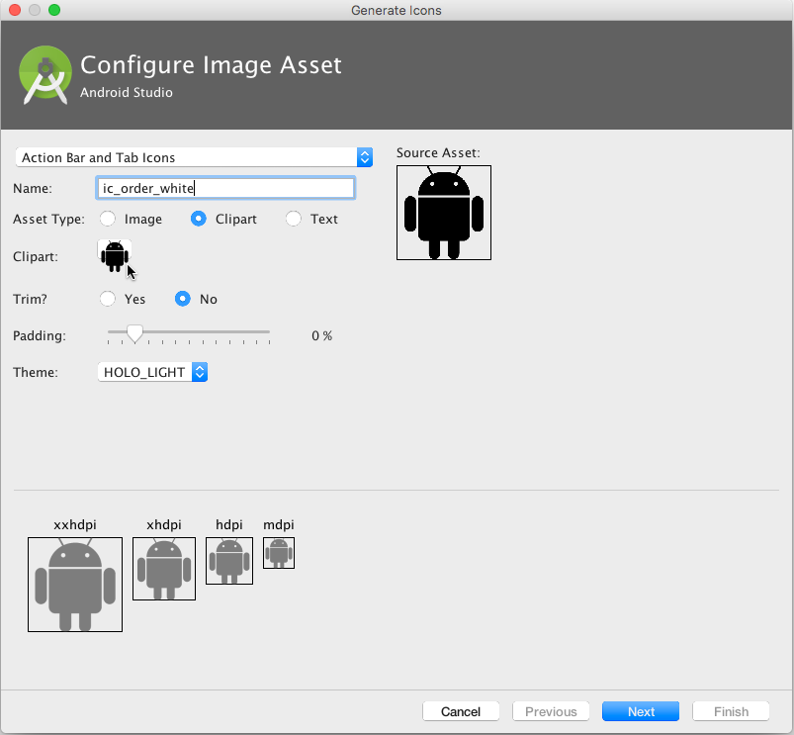
Add icons for menu items
Right-click drawable
Choose New > Image Asset
Choose Action Bar and Tab Items
Edit the icon name
Click clipart image, and click icon
Click Next, then Finish

Slide 13
Add menu item attributes
<item android:id="@+id/action_order"
android:icon="@drawable/ic_toast_dark"
android:title="@string/toast"
android:titleCondensed="@string/toast_condensed" android:orderInCategory="1" app:showAsAction="ifRoom" />

Slide 14
Override onOptionsItemSelected()
@Override
public boolean onOptionsItemSelected(MenuItem item) {
switch (item.getItemId()) {
case R.id.action_order:
showOrder();
return true;
default:
return super.onOptionsItemSelected(item);
}
}

Slide 15
Contextual Menus

Slide 16
What are contextual menus?
Allow users to perform an action on a selected view or content
Can be deployed on any View object, but most often used for items in a RecyclerView, GridView, or other view collection

Slide 17
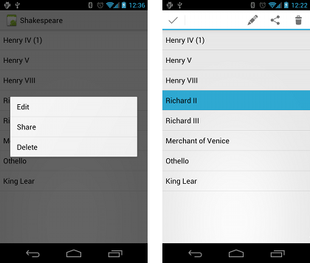
Types of contextual menus
Floating context menu—floating list of menu items when long-presses on a view element
User can modify the view element or use it in some fashion
Users perform a contextual action on one view element at a time
Contextual action mode—temporary action bar in place of or underneath the app bar
Action items affect the selected view element(s)
Users can perform action on multiple view elements at once

Slide 18
Floating Context Menu

Slide 19
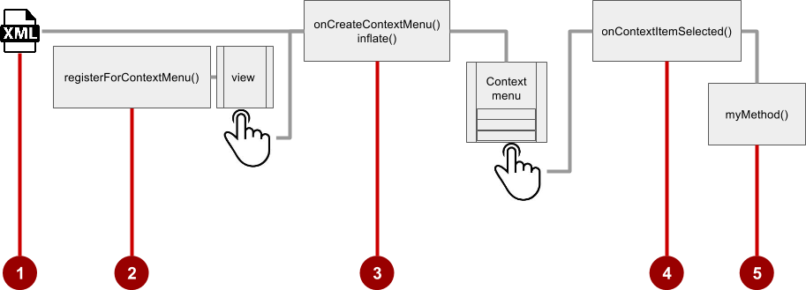
Steps
Create XML menu resource file and assign appearance and position attributes
Register view to use a context menu using registerForContextMenu()
Implement onCreateContextMenu() in the activity or fragment to inflate the menu
Implement onContextItemSelected() to handle menu item clicks
Create a method to perform an action for each context menu item

Slide 20
Create menu resource
Create XML menu resource (menu_context.xml)
<item
android:id="@+id/context_edit"
android:title="@string/edit"
android:orderInCategory="10"/>
<item
android:id="@+id/context_share"
android:title="@string/share"
android:orderInCategory="20"/>

Slide 21
Register a view to a context menu
in onCreate() of the activity
registers View.OnCreateContextMenuListener
Does not specify which context menu!
TextView article_text = (TextView) findViewById(R.id.article);
registerForContextMenu(article_text);

Slide 22
Implement onCreateContextMenu() onCreateContextMenu() method
Specifies which context menu
@Override
public void onCreateContextMenu(ContextMenu menu, View v,
ContextMenu.ContextMenuInfo menuInfo) {
super.onCreateContextMenu(menu, v, menuInfo);
MenuInflater inflater = getMenuInflater();
inflater.inflate(R.menu.menu_context, menu);
}

Slide 23
Implement onContextItemSelected() onCreateContextMenu() method
@Override
public boolean onContextItemSelected(MenuItem item) {
switch (item.getItemId()) {
case R.id.context_edit:
editNote();
return true;
default:
return super.onContextItemSelected(item);
}
}
The view

Slide 24
Contextual Action Bar

Slide 25
What is Action Mode?
ActionMode is a UI mode that lets you replace parts of the normal UI interactions temporarily
For example, selecting a section of text or long-pressing an item could trigger action mode
Action bar
Regular UI interaction
Action Mode

Slide 26
Action mode has a lifecycle
Start it with startActionMode(), for example, in the listener
ActionMode.Callback interface provides the lifecycle methods that you can override
onCreateActionMode(ActionMode, Menu) once on initial creation
onPrepareActionMode(ActionMode, Menu) after creation and any time ActionMode is invalidated
onActionItemClicked(ActionMode, MenuItem) any time a contextual action button is clicked
onDestroyActionMode(ActionMode) when the action mode is closed

Slide 27
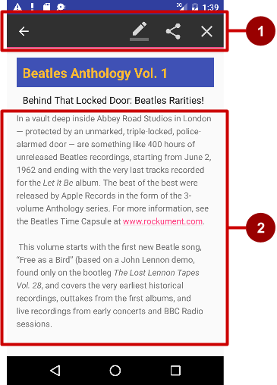
What is a contextual action bar?
Long-tap on the view shows contextual action bar
Contextual action bar with actions
Edit, Share, and Delete
Done (left arrow icon) on the left side
View on which long press triggers the contextual action bar
Action bar is available until user taps Done

Slide 28
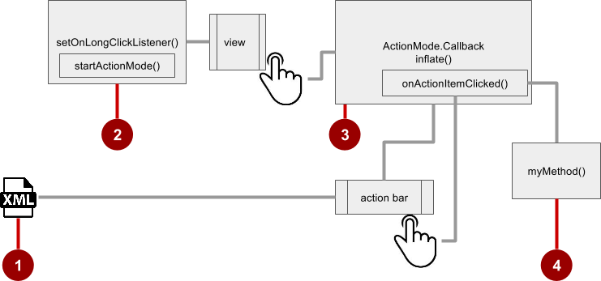
Steps for contextual action bar
Create XML menu resource file and assign icons for items
setOnLongClickListener() on view that triggers the contextual action bar and call startActionMode() to handle click
Implement ActionMode.Callback interface to handle ActionMode lifecycle; include action for a menu item click in onActionItemClicked() callback
Create a method to perform an action for each context menu item

Slide 29
Use setOnLongClickListener
private ActionMode mActionMode;
In onCreate
View view = findViewById(article);
view.setOnLongClickListener(new View.OnLongClickListener() {
public boolean onLongClick(View view) {
if (mActionMode != null) return false;
mActionMode =
MainActivity.this.startActionMode(mActionModeCallback);
view.setSelected(true);
return true;
}
});

Slide 30
Implement mActionModeCallback
public ActionMode.Callback mActionModeCallback =
new ActionMode.Callback() {
// Implement action mode callbacks here
};

Slide 31
Implement onCreateActionMode
@Override
public boolean onCreateActionMode(ActionMode mode, Menu menu) {
MenuInflater inflater = mode.getMenuInflater();
inflater.inflate(R.menu.menu_context, menu);
return true;
}

Slide 32
Implement onPrepareActionMode
Called each time the action mode is shown
Always called after onCreateActionMode, but may be called multiple times if the mode is invalidated
@Override
public boolean onPrepareActionMode(ActionMode mode, Menu menu) {
return false; // Return false if nothing is done.
}

Slide 33
Implement onActionItemClicked
Called when users selects an action
Handle clicks in this method
@Override
public boolean onActionItemClicked(ActionMode mode, MenuItem item) {
switch (item.getItemId()) {
case R.id.goodbyetextview:
Toast.makeText(getApplicationContext(), "Menu Toast", Toast.LENGTH_SHORT).show();
mode.finish(); // Action picked, so close the action bar
return true;
default:
return false;
}
}

Slide 34
Implement onDestroyActionMode
Called when user exits the action mode
@Override
public void onDestroyActionMode(ActionMode mode) {
mActionMode = null;
}

Slide 35
Popup Menu

Slide 36
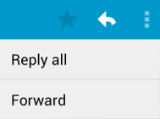
What is a popup menu?
Vertical list of items anchored to a view
Typically anchored to a visible icon
Actions should not directly affect view content
The options menu overflow that opens Settings
For example, in an email app, Reply All and Forward are related to the email message, but don’t affect or act on the message

Slide 37
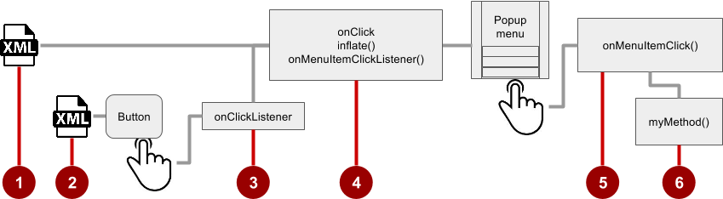
Steps
Create XML menu resource file and assign appearance and position attributes
Add an ImageButton for the popup menu icon in the XML activity layout file
Assign onClickListener to the button
Override onClick() to inflate the popup and register it with onMenuItemClickListener()
Implement onMenuItemClick()
Create a method to perform an action for each popup menu item

Slide 38

Add an ImageButton
<ImageButton
android:layout_width="wrap_content"
android:layout_height="wrap_content"
android:id="@+id/button_popup"
android:src="@drawable/@drawable/ic_action_popup"/>

Slide 39
Assign onClickListener to button
private ImageButton mButton = (ImageButton) findViewById(R.id.button_popup);
In onCreate:
mButton.setOnClickListener(new View.OnClickListener() {
// define onClick
});

Slide 40
Implement onClick
@Override
public void onClick(View v) {
PopupMenu popup = new PopupMenu(MainActivity.this, mButton);
popup.getMenuInflater().inflate(
R.menu.menu_popup, popup.getMenu());
popup.setOnMenuItemClickListener( new PopupMenu.OnMenuItemClickListener() {
// implement click listener
});
popup.show();
}

Slide 41
Implement onMenuItemClick
public boolean onMenuItemClick(MenuItem item) {
switch (item.getItemId()) {
case R.id.option_toast:
Toast.makeText(getApplicationContext(), "Popup Toast",
Toast.LENGTH_SHORT).show();
return true;
default:
return false;
}
}

Slide 42
Learn more
Adding the App Bar
Styles and Themes
Menus
Menu Resource

Slide 43
What's Next?
Concept Chapter: 4.2 C Menus
Practical: 4.2 P Using an Options Menu

Slide 44
END

